Slide 1



Pizza Sales Analysis
View in Power BI
Last data refresh:
7/23/2023 2:51:25 PM UTC
Downloaded at:
7/23/2023 3:02:32 PM UTC

Slide 2
Measures using DAX :
Total Revenue = SUM(pizza_sales[total_price])
Total Pizzas Sold = SUM(pizza_sales[quantity])
Total Orders = DISTINCTCOUNT(pizza_sales[order_id])
Average Order Value = Total Revenue / Total Orders
Average Pizzas per Order = Total Pizzas Sold / Total Orders
Custom columns using DAX :
month number = MONTH(pizza_sales[order_date].[DATE])
day number = WEEKDAY(pizza_sales[order_date].[DATE])
hour = HOUR(pizza_sales[order_time])

Slide 3
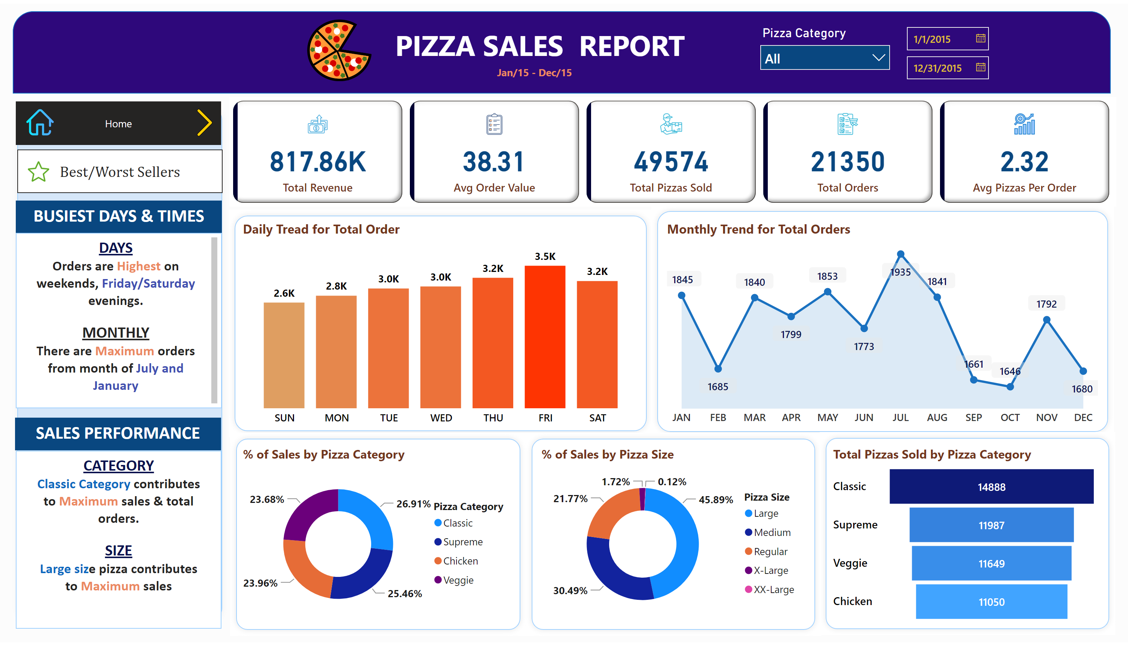
Home
Notes:
cardVisual
No alt text provided
shape
No alt text provided
Daily Tread for Total Order
No alt text provided
Monthly Trend for Total Orders
No alt text provided
shape
No alt text provided
% of Sales by Pizza Category
No alt text provided
% of Sales by Pizza Size
No alt text provided
Total Pizzas Sold by Pizza Category
No alt text provided
shape
No alt text provided
textbox
No alt text provided
textbox
No alt text provided
textbox
No alt text provided
textbox
No alt text provided
pageNavigator
No alt text provided
pageNavigator
No alt text provided
image
No alt text provided
image
No alt text provided
image
No alt text provided
shape
No alt text provided
shape
No alt text provided
shape
No alt text provided
shape
No alt text provided
textbox
No alt text provided
textbox
No alt text provided
slicer
No alt text provided
image
No alt text provided
slicer
No alt text provided

Slide 4
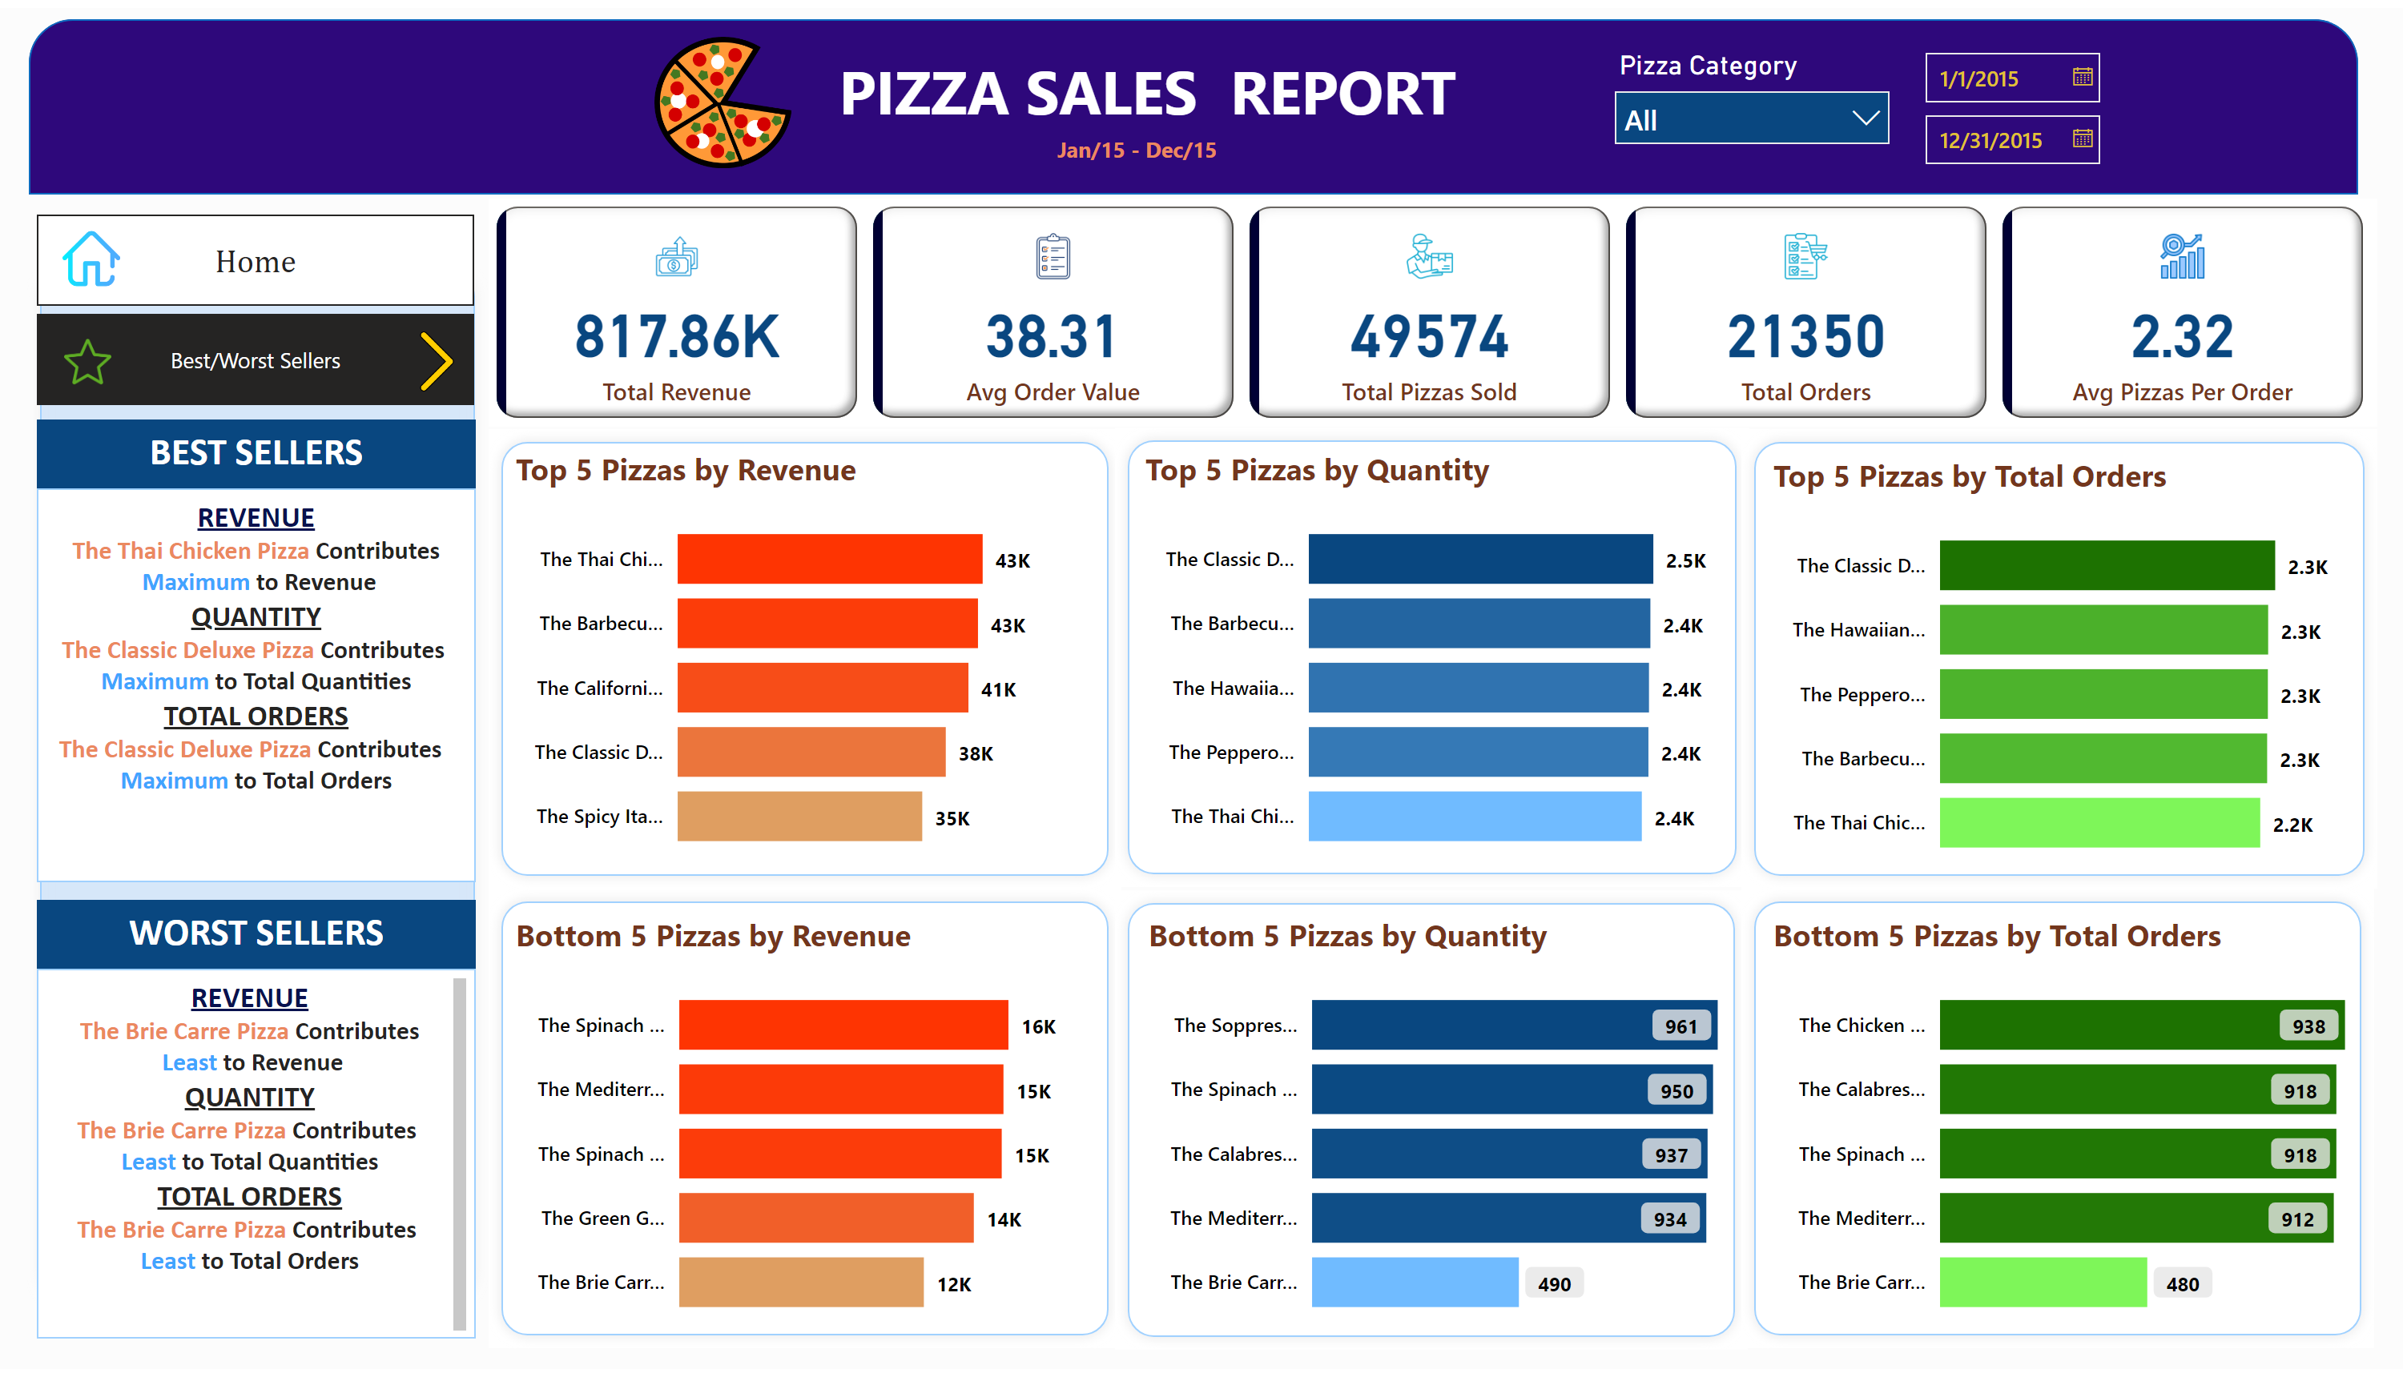
Best/Worst Sellers
Notes:
cardVisual
No alt text provided
shape
No alt text provided
shape
No alt text provided
textbox
No alt text provided
textbox
No alt text provided
textbox
No alt text provided
textbox
No alt text provided
shape
No alt text provided
shape
No alt text provided
shape
No alt text provided
shape
No alt text provided
shape
No alt text provided
Top 5 Pizzas by Revenue
No alt text provided
Bottom 5 Pizzas by Revenue
No alt text provided
Top 5 Pizzas by Quantity
No alt text provided
Bottom 5 Pizzas by Quantity
No alt text provided
Top 5 Pizzas by Total Orders
No alt text provided
Bottom 5 Pizzas by Total Orders
No alt text provided
pageNavigator
No alt text provided
pageNavigator
No alt text provided
image
No alt text provided
image
No alt text provided
image
No alt text provided
shape
No alt text provided
textbox
No alt text provided
textbox
No alt text provided
slicer
No alt text provided
image
No alt text provided
slicer
No alt text provided

